Slide 1

Cloud Native Meetup February 2026
Sponsored by Telemetry Forge

Slide 2
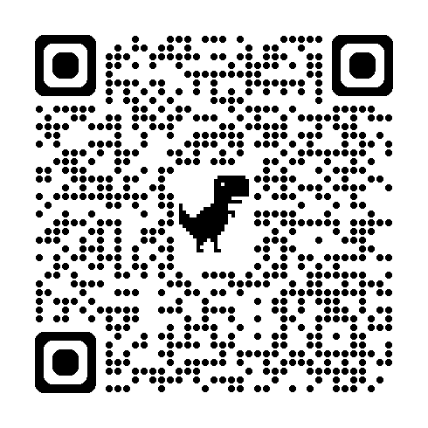
Announcements
Official CNCF meetup now, please “mark attendance” there:
https://community.cncf.io/events/details/cncf-cloud-native-manchester-presents-cloud-native-february/
Next Manchester meetup: April 15th at Bonded Warehouse again
Will run via the CNCF event with the meetup page as well
Sponsors, talks needed so please reach out: contact@cloudnativemcr.co.uk

Slide 3
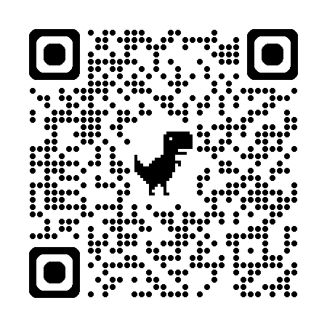
Sponsor: Telemetry Forge
https://telemetryforge.io
Bespoke software consultancy with a focus on observability.
Pragmatic approaches to build the telemetry platform (or anything else) you actually want.
Founded by core maintainers of Fluent Bit, many years of experience in the domain.

Slide 4
Making cloud-native stream processing mundane with Bento

Slide 5
Understanding the software supply chain

Slide 6
See you next time
Sponsors, talks needed so please reach out:
contact@cloudnativemcr.co.uk
Please register on the CNCF side:
https://community.cncf.io/events/details/cncf-cloud-native-manchester-presents-cloud-native-february/
Next Manchester meetup: April 15th at Bonded Warehouse again
Glasgow meetup: March 12th
https://www.meetup.com/cloudnativeglasgow/events/313280028

